Slide 1

Department of CSIT
COURSE NAME
FOUNDATIONS OF CLOUD-NATIVE COMPUTING & DEVOPS
COURSE CODE –24CS2260F
Topic:
Basic policy management (admission controllers high-level)
Session - 2

Slide 2
Introduction to Policy Management
In Kubernetes, many developers deploy applications in the same cluster. Sometimes they may deploy applications with wrong configurations, which can cause security or performance problems. So we use Policy Management.
Simple meaning: Policy management means defining rules for how applications should be deployed in Kubernetes so that everything stays secure and organized.
In Kubernetes, policies ensure:
Secure containers
Limited resource usage
Standard configurations
Without policies:
Containers may run with admin privileges
Applications may use too much CPU or memory
Security rules may be broken

Slide 3
Admission Controllers
Admission Controllers are components that check and control requests before they are saved in Kubernetes.
They act like gatekeepers.
They can:
Allow request
Reject request
Modify request
Example command:
kubectl apply -f deployment.yaml
This means:
The request goes through Admission Control, where Kubernetes checks rules and policies before allowing the resource.

Slide 4
Examples
Scenario 1: Preventing Unsafe Containers
Situation
A developer deploys a pod that runs with root privileges. Running containers as root can be dangerous because attackers may gain full control of the system.
What Happens in Kubernetes
When the developer runs:
kubectl apply -f pod.yaml
The request goes to the Kubernetes API Server.
Before the pod is created, the Admission Controller checks the configuration.
The Pod Security Admission policy detects that the container is running with privileged access.
Result
The Admission Controller rejects the request.

Slide 5
Scenario 2: Limiting Resource Usage
Situation
A team deploys many applications that consume too much CPU and memory, which may crash the cluster.
What Happens in Kubernetes
The cluster administrator creates a ResourceQuota policy.
Example rule:
Maximum CPU = 4
Maximum Memory = 8GB
When a developer tries to deploy an application requiring 10 CPUs, the Admission Controller checks the request.
Result
The request is rejected because it exceeds the quota.

Slide 6
Scenario 3: Automatically Adding Default Configuration (Mutating Controller)
Situation
A developer deploys an application but forgets to specify CPU and memory limits.
Without limits, the application might consume excessive resources.
What Happens in Kubernetes
A Mutating Admission Controller automatically adds default CPU and memory values.
Example:
CPU:0.5 Memory: 512MB
Result :The request is modified and then accepted.

Slide 7
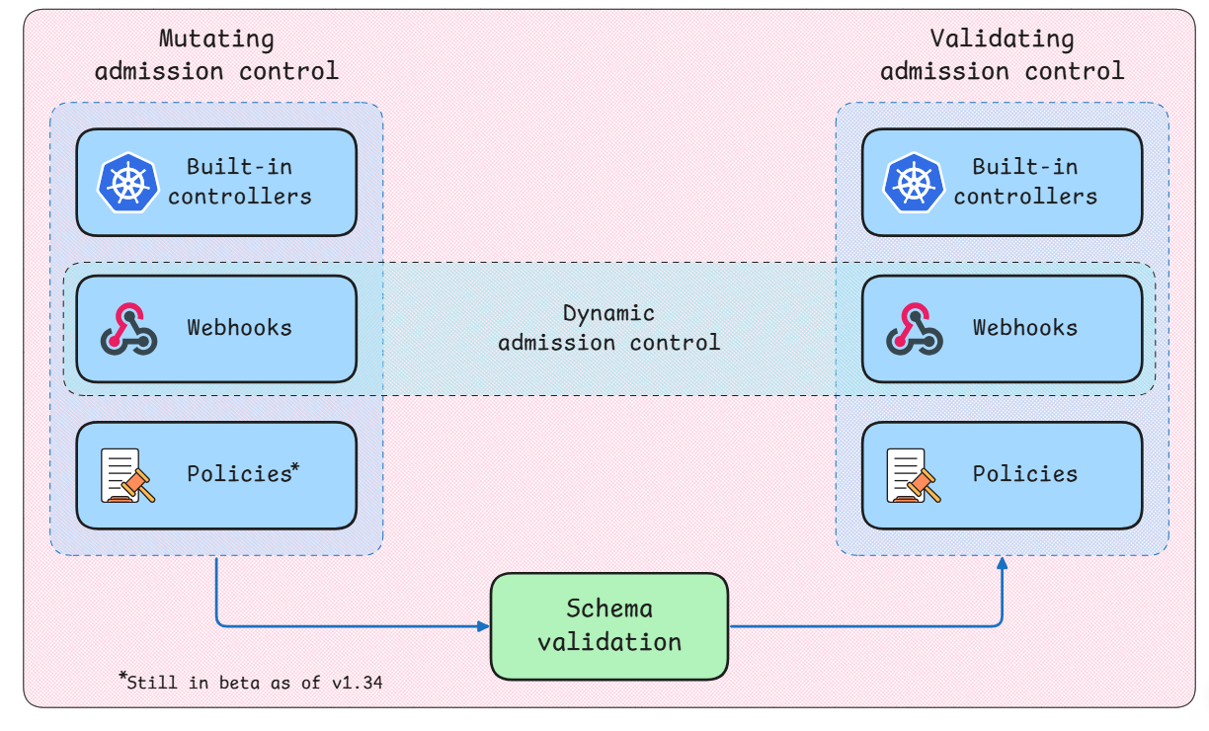
Admission Control Phases

Slide 8
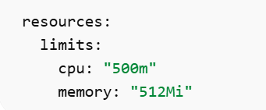
1. Mutating Admission Control
Mutating means changing or modifying the request before it is accepted.
If something is missing, Kubernetes can automatically add or modify it.
Components in Mutating Admission
a) Built-in Controllers
These are controllers already available in Kubernetes.
They automatically modify requests.
Example: If a pod is created without resource limits, Kubernetes may add default values.

Slide 9
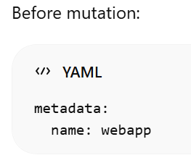
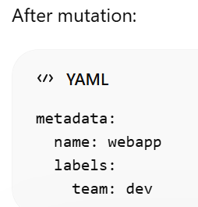
b) Webhooks
Webhooks allow custom programs to modify requests.
Organizations can write their own rules.
Example:
A company policy says:
Every pod must contain label team=dev.
If a developer forgets it, the webhook automatically adds it.

Slide 10
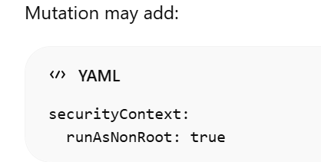
C)Policies
Policies define rules for modifying resources automatically.
Example policy:
All containers must run with non-root user.

Slide 11
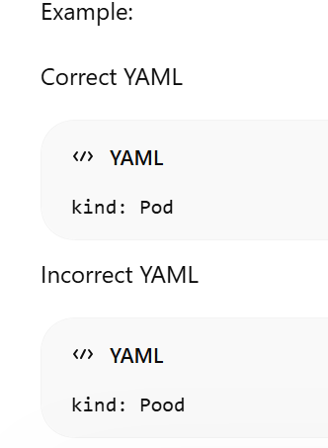
2.Schema Validation (Middle Part)
After mutation, Kubernetes checks whether the configuration structure is correct.
This is called schema validation.
The system will reject incorrect structures immediately.

Slide 12
3. Validating Admission Control
Validating means checking rules but NOT modifying anything.
It only decides:
Allow
Reject
a) Built-in Controllers
Kubernetes already provides controllers like:
ResourceQuota
LimitRanger
PodSecurity
Example:
If namespace limit is:
CPU = 4 cores
A developer requests:
CPU = 8 cores
The request is rejected.

Slide 13
b) Webhooks
Organizations can write custom validation checks.
Example rule:
Pods cannot use latest image tag.
Developer request:
image: nginx:latest
Webhook rejects the request.
Error example:
Image tag "latest" not allowed

Slide 14

c)Policies
Policies = Rules that every application must follow before being allowed into the Kubernetes cluster.
Policies are enforced by Admission Controllers during the request process.
Example:
Organization policy:
Containers must not run in privileged mode.
But Developer requested to run in privileged mode
Result:
Deployment blocked.

Slide 15

THANK YOU
Team –Foundations Of Cloud-native Computing & Devops

